Slide 1



Disaster Response Coordination
A Java-Based Disaster Management System
TANVIK SRI RAM REDDY (URK23CS1261)

Slide 2


Introduction
The Disaster Response Coordination system coordinates admin, co-admin, volunteers, and users during disasters. It ensures efficient resource allocation and clear communication.

Slide 3
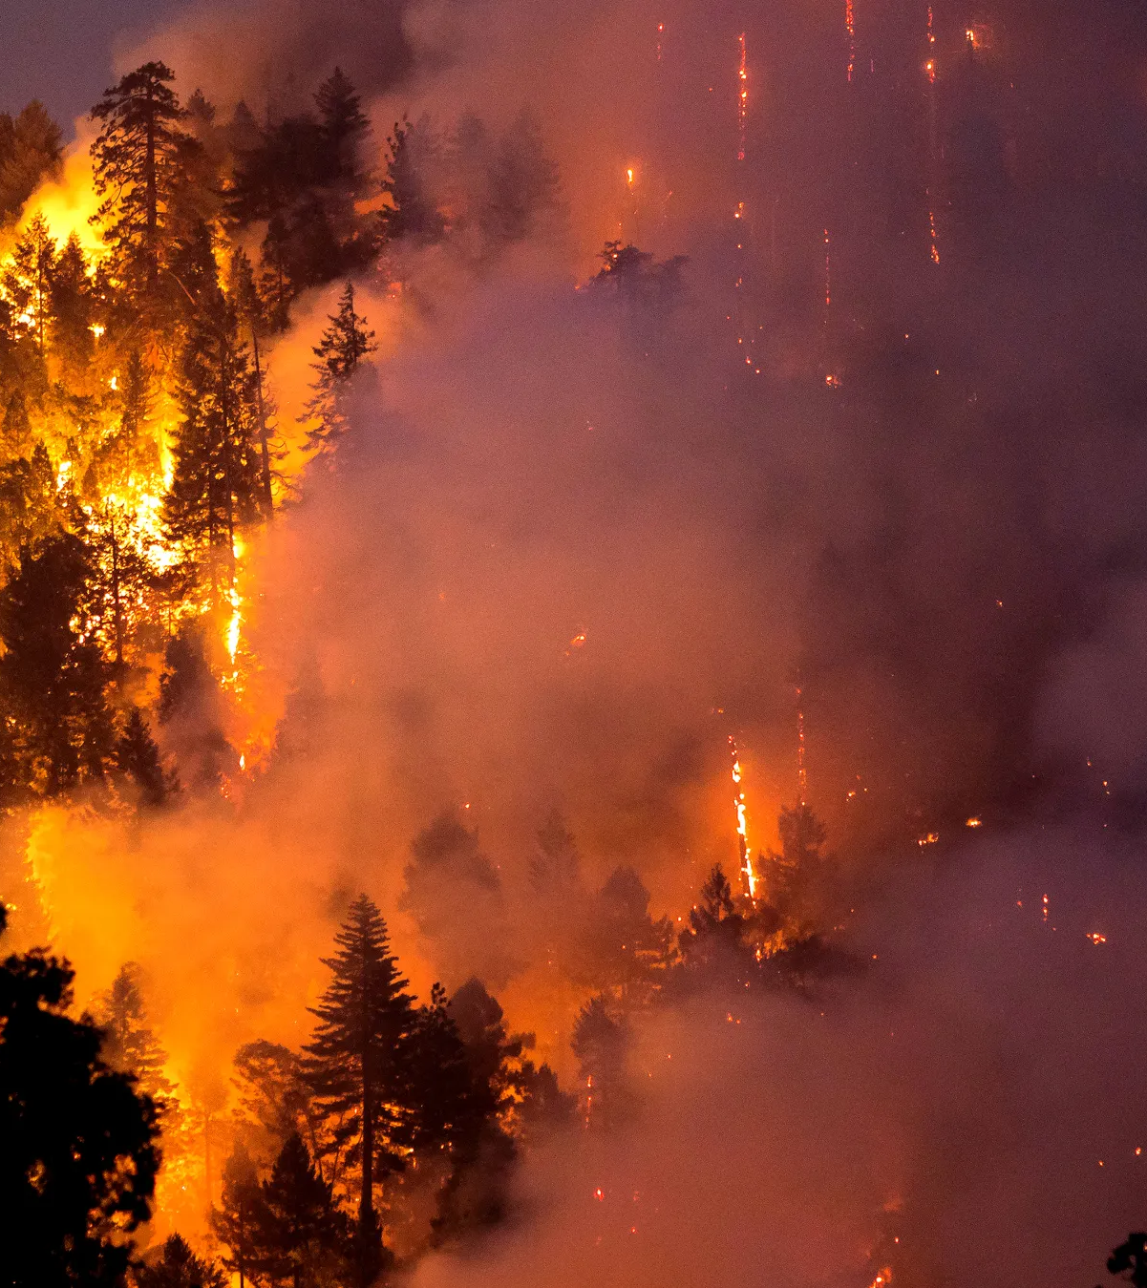
Motivation
In disaster scenarios, quick response and resource management are crucial to saving lives and minimizing damage.
This project aims to automate and streamline these processes.

Slide 4
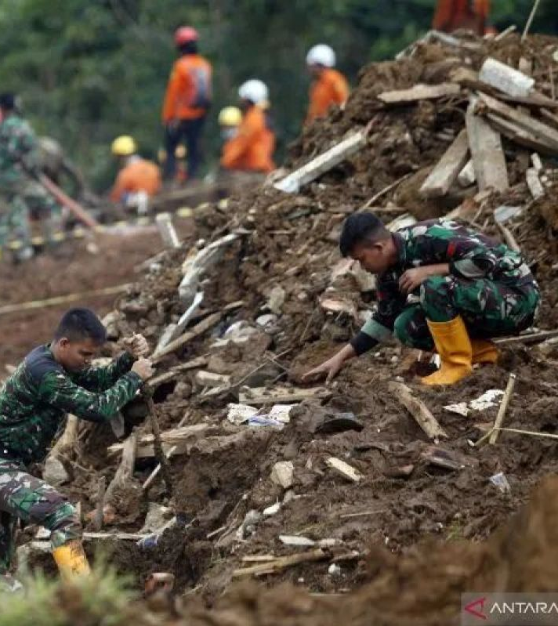
Problem Statement
Manual disaster response leads to delays, miscommunication, and inefficient resource use. A streamlined platform is needed to manage disaster response efficiently.
Notes:
This system is designed for organizations and volunteers involved in disaster management.

Slide 5
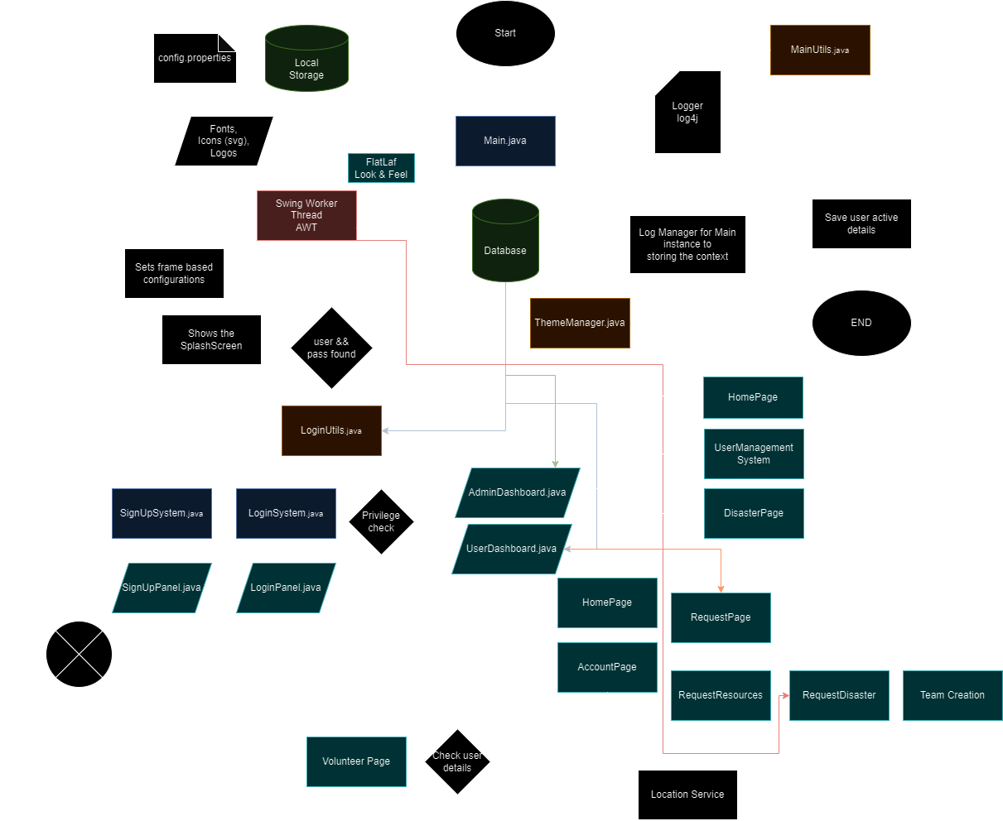
System Overview
Basic flowchart model for RESQIT
MVC (Model-View-Controller) architecture

Slide 6

Model
Handles the core logic of the application, such as disaster requests, user data, user roles, resource management.

Slide 7

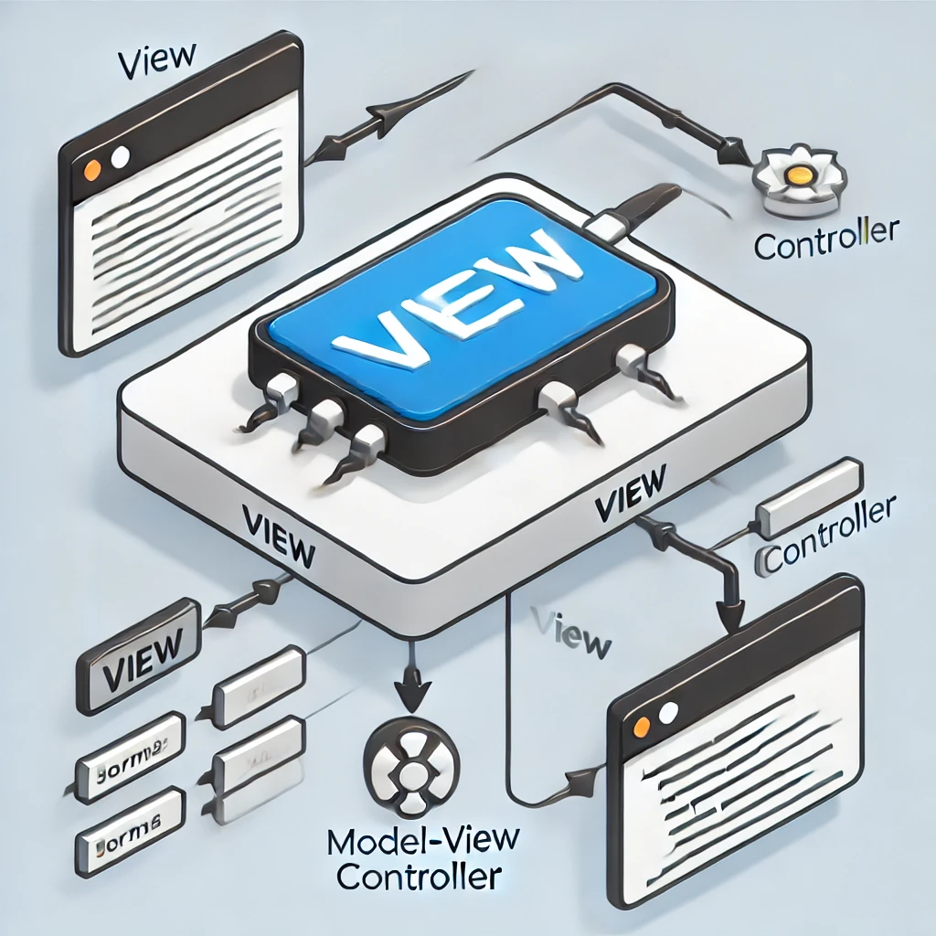
View
Consists of the user interface elements created using the Swing-based UI components.

Slide 8

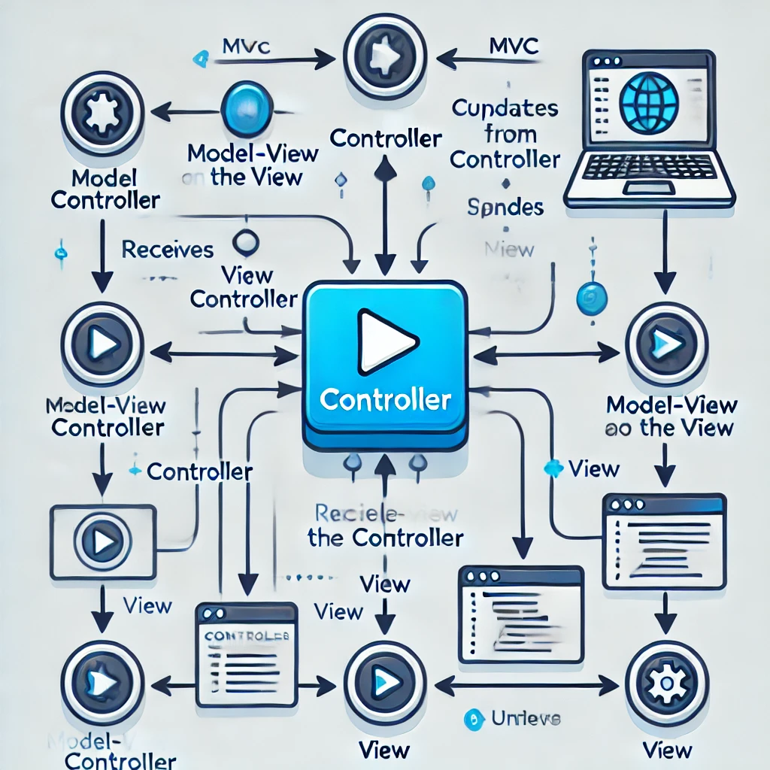
Controller
Manages the flow of data between the Model and the View (e.g., handling user inputs, updating views based on actions).

Slide 9




System Features
User Authentication: Secure login and registration for different user roles.
Role-Based Access Control: Differentiated functionalities for admin, co-admin, volunteer, and regular users.
Volunteer Management: Registration and profile management for volunteers.
Disaster Requests: Users can view and respond to disaster requests.
Dashboard Interface: User-friendly dashboards tailored to user roles.
Resource Management: Access to resources relevant to disaster response.
User Management: Admin capabilities for managing user accounts and roles.

Slide 10

Future Enhancements
Complete Dashboard: Implement the full functionality of dashboards for admin, co-admin, and volunteers.
Resource Optimization: Improve resource allocation.
Improvement in UI and Data abstraction.
Improving datebase using DRM ( Database relational mapping, json, etc)

Slide 11

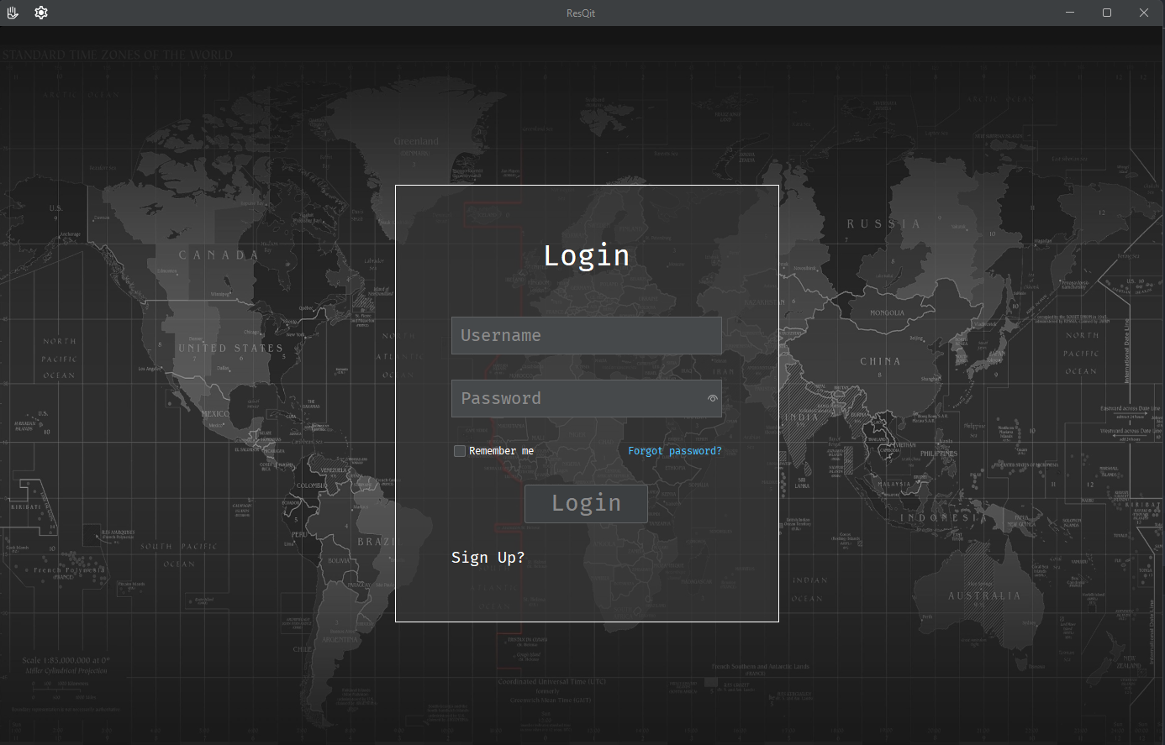


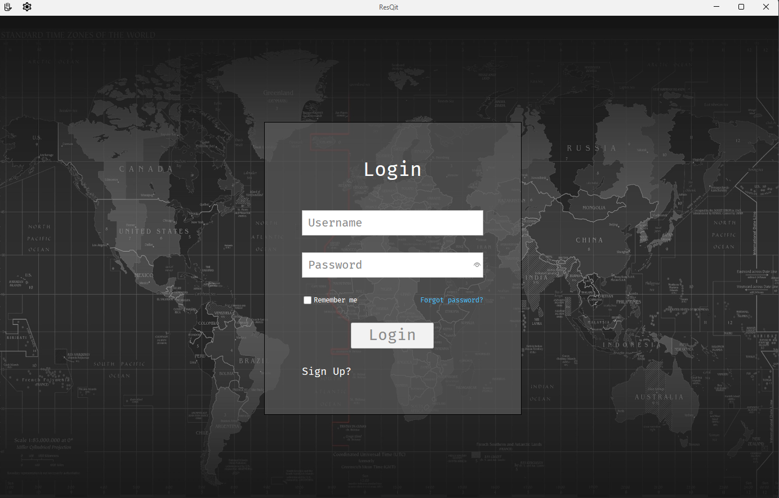
Implementation
Login Screen
Icons
Splash Screen

Slide 12
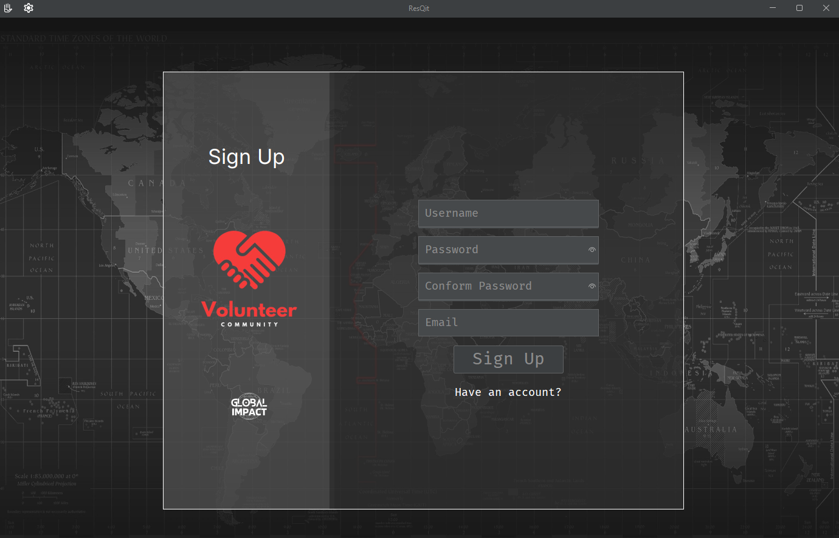
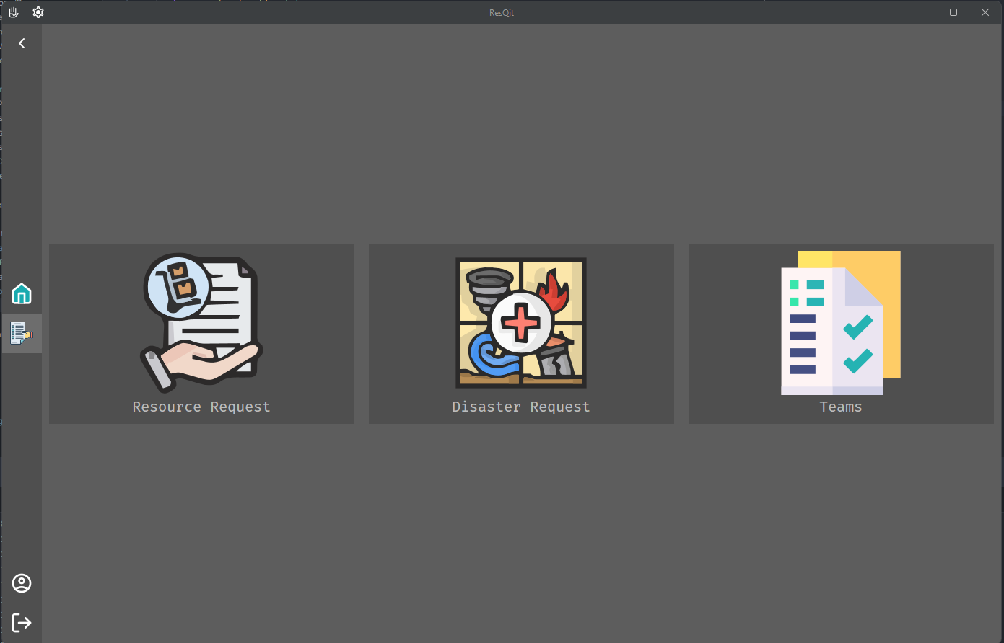
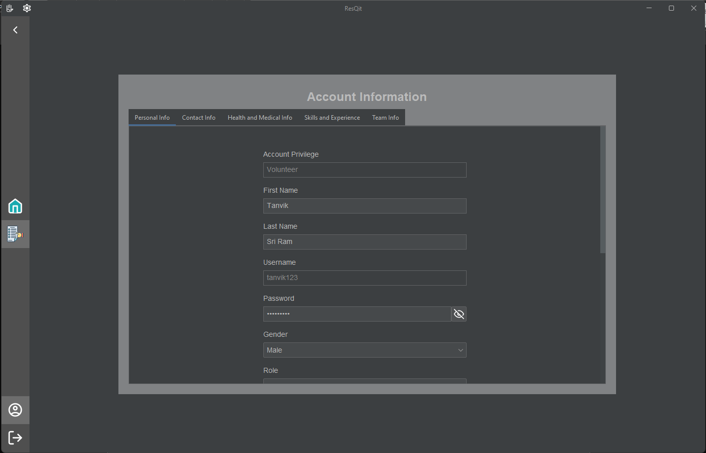
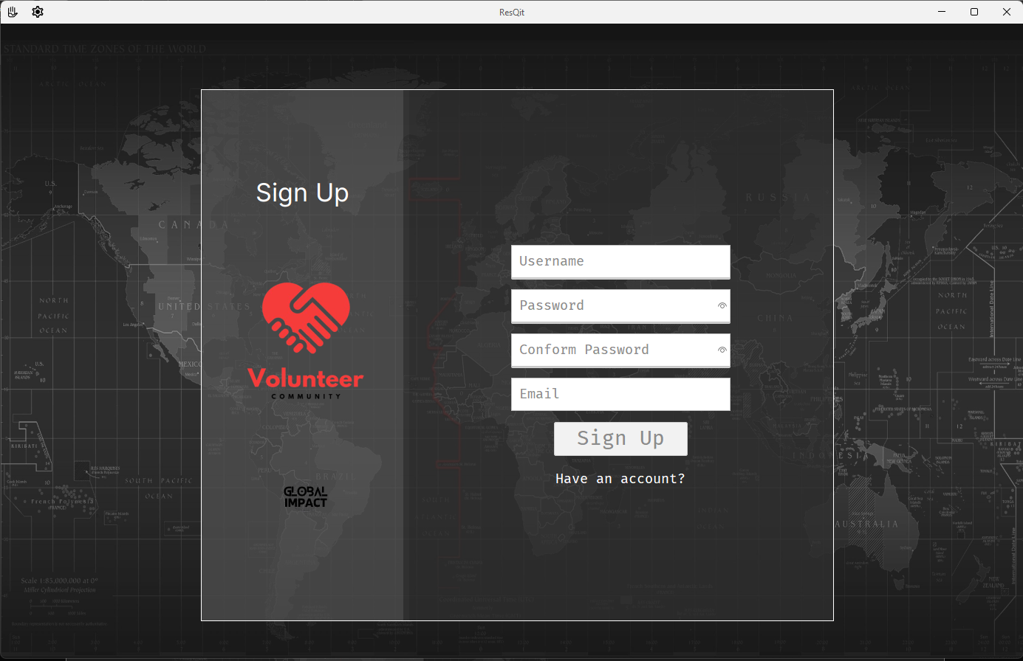
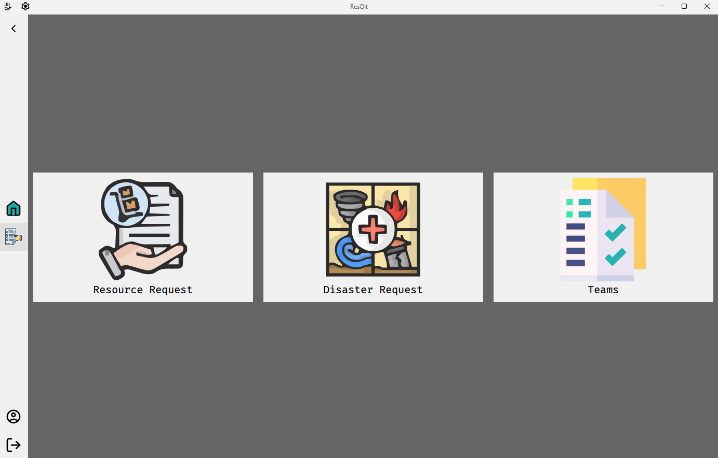
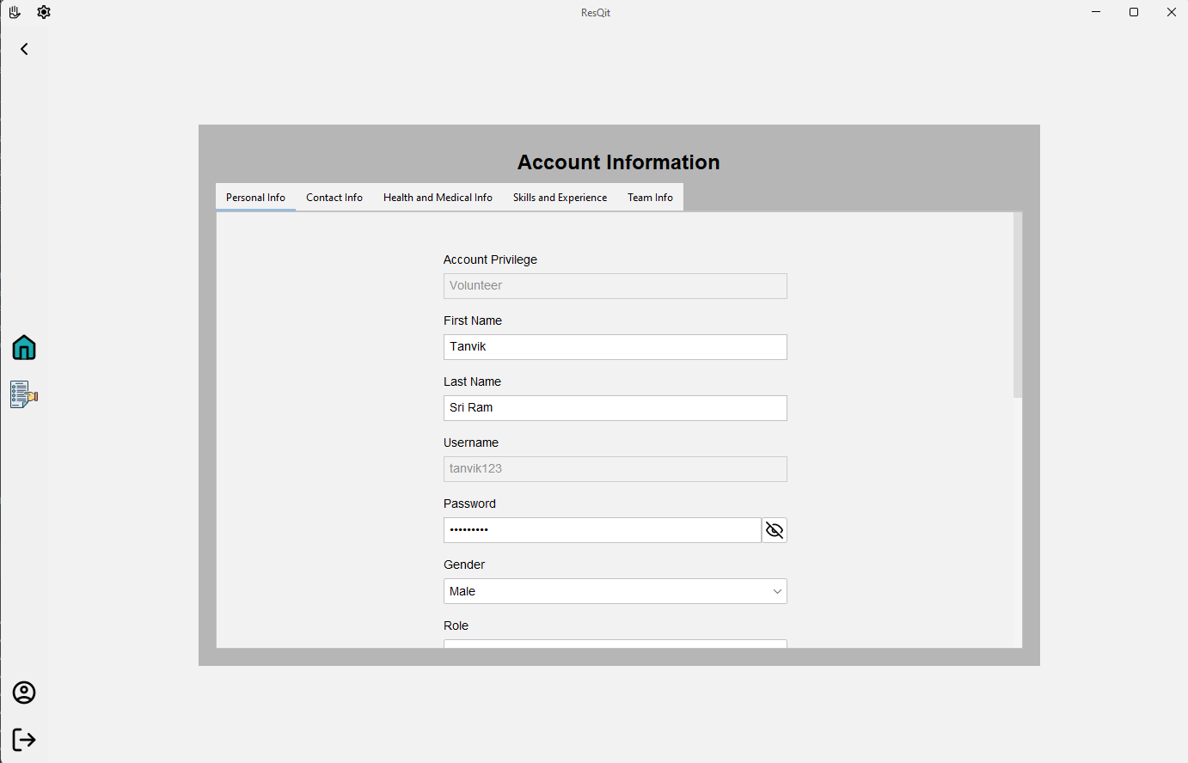
Sign Up Page
Request Page
Account Page

Slide 13
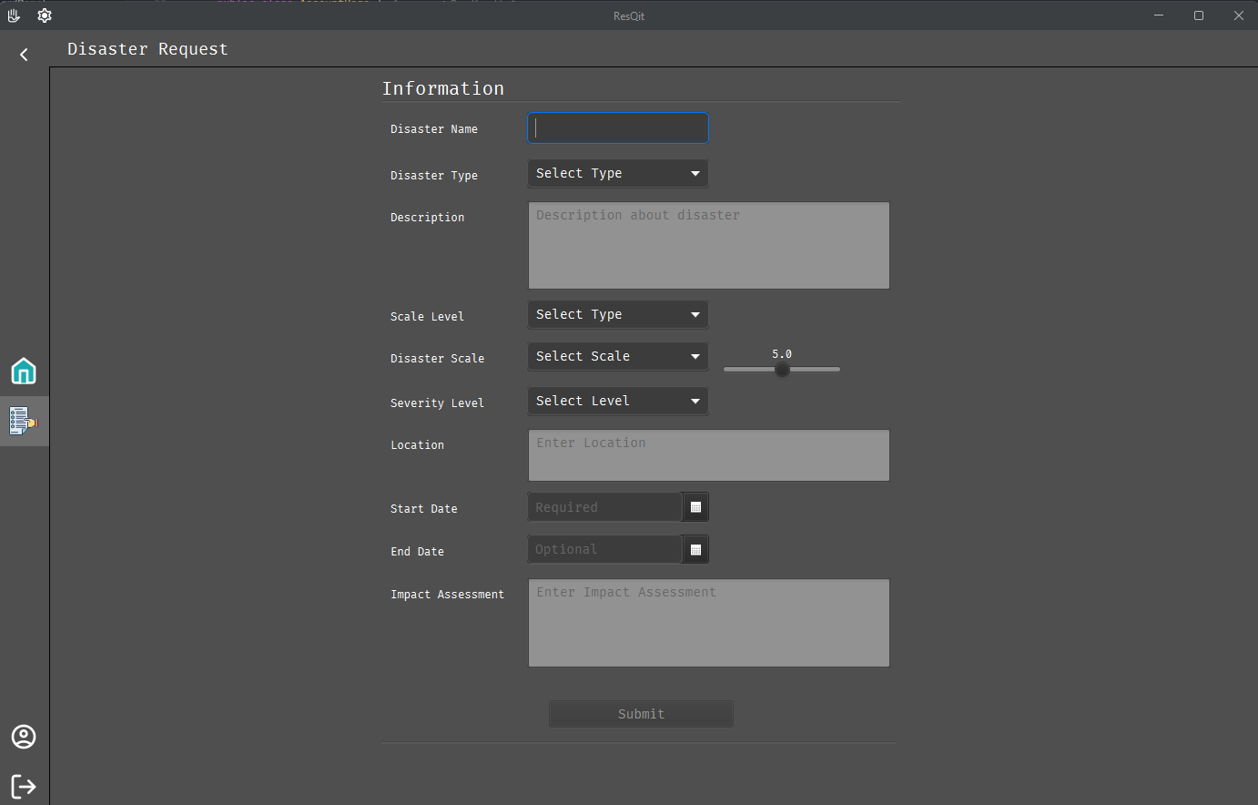
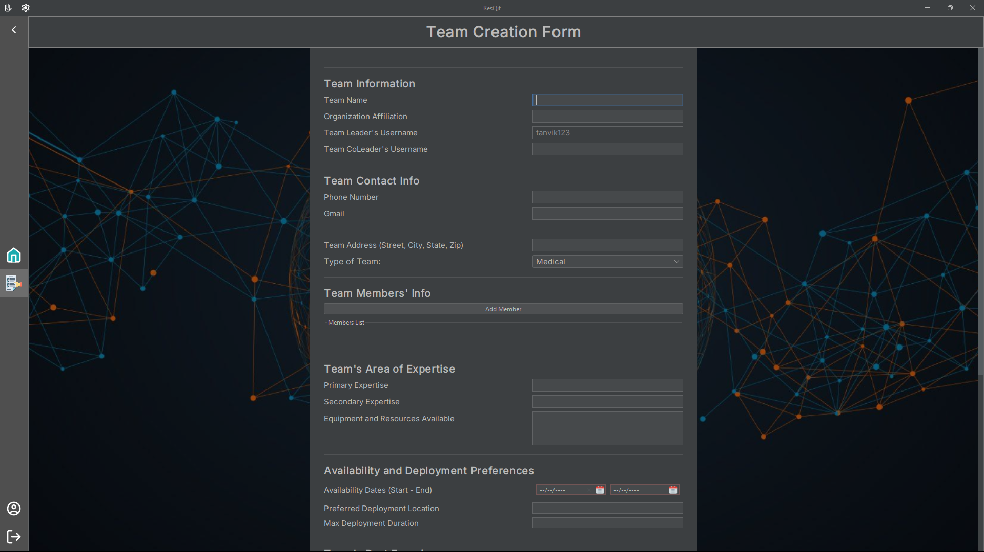
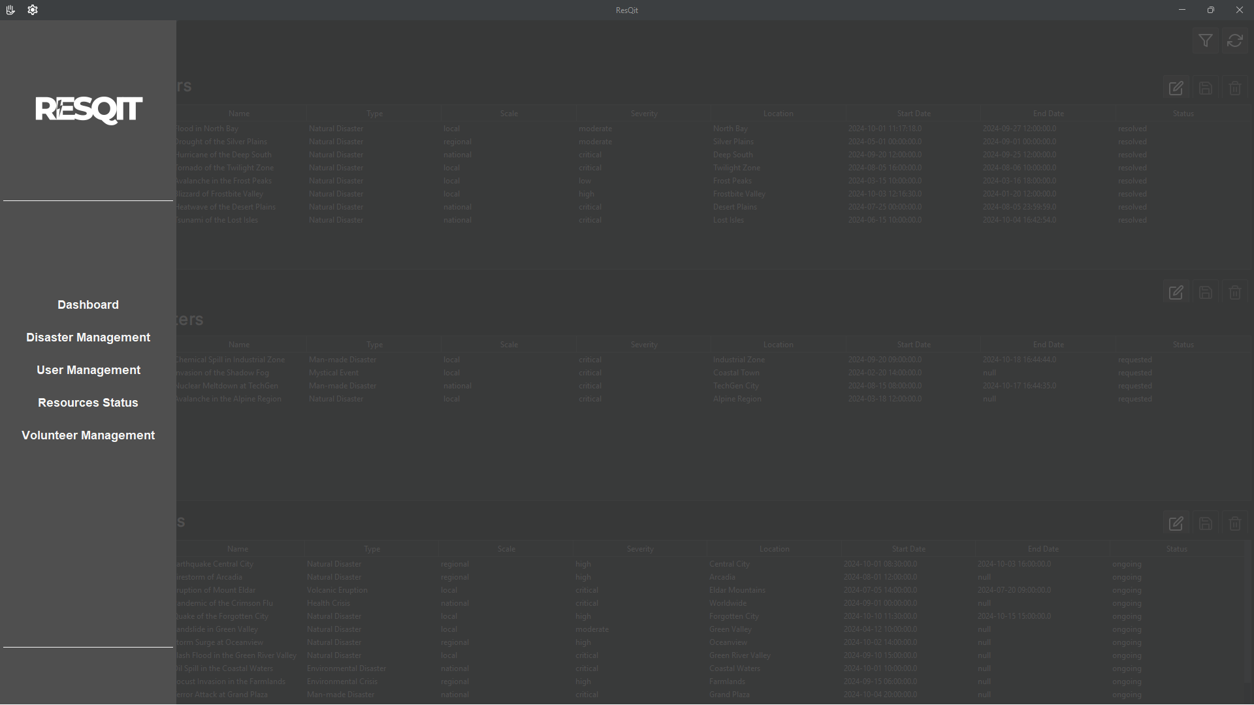
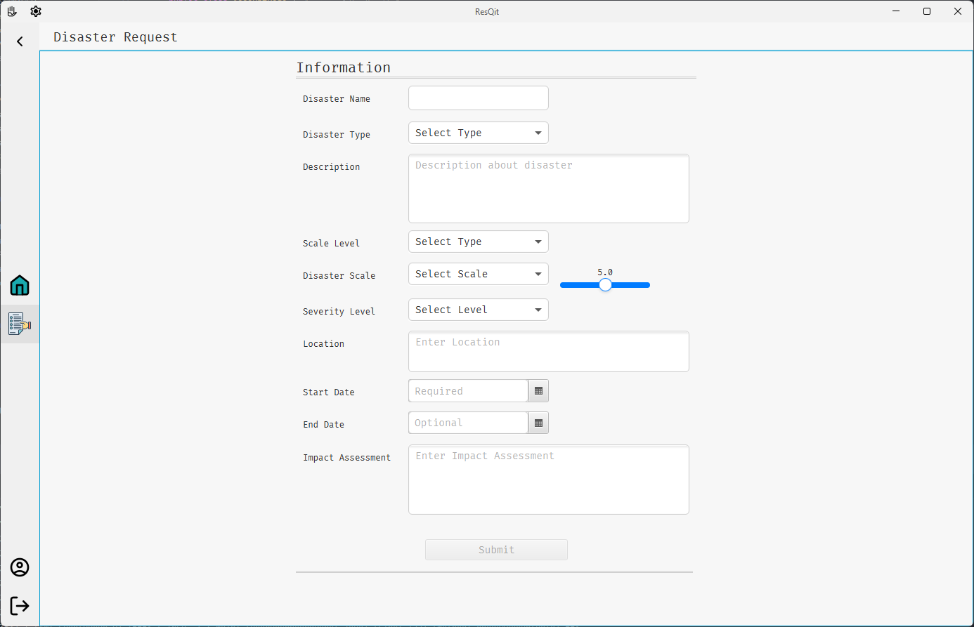
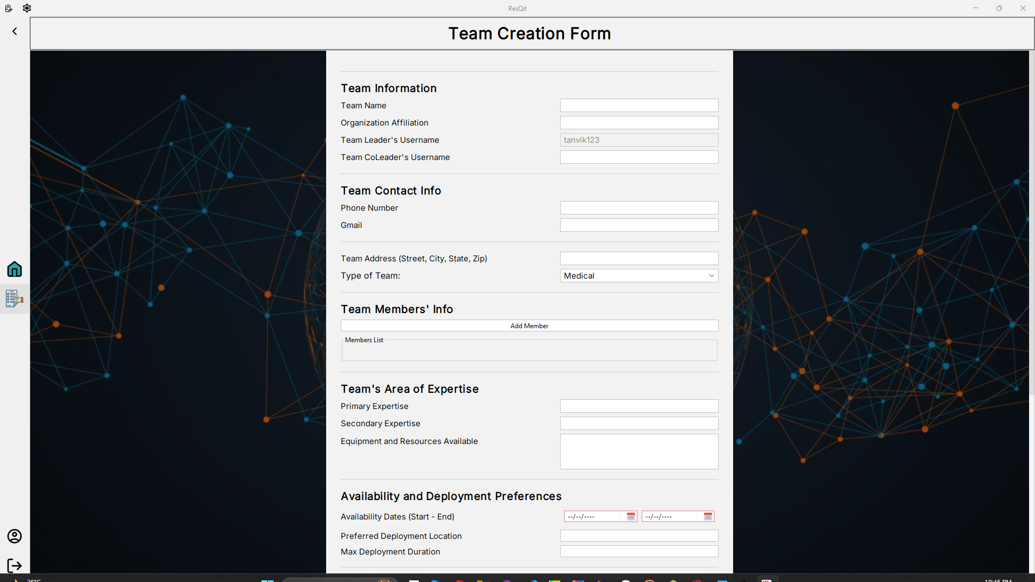
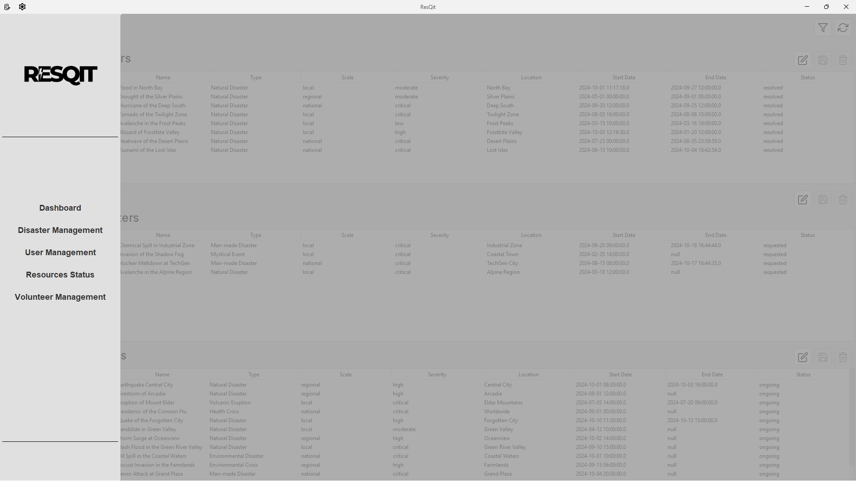
Disaster Request Page
Team Creation Page
Admin side bar

Slide 14
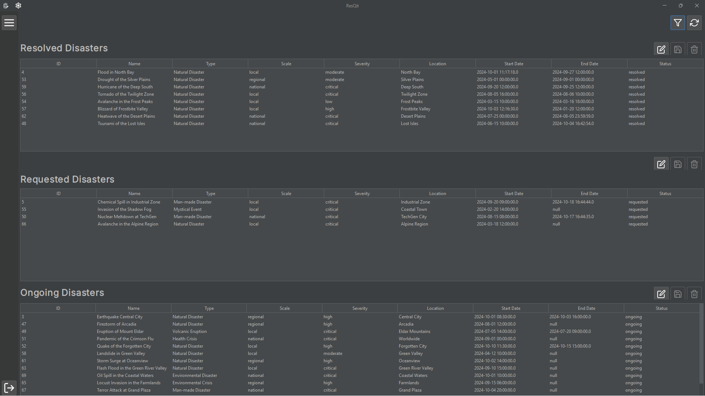
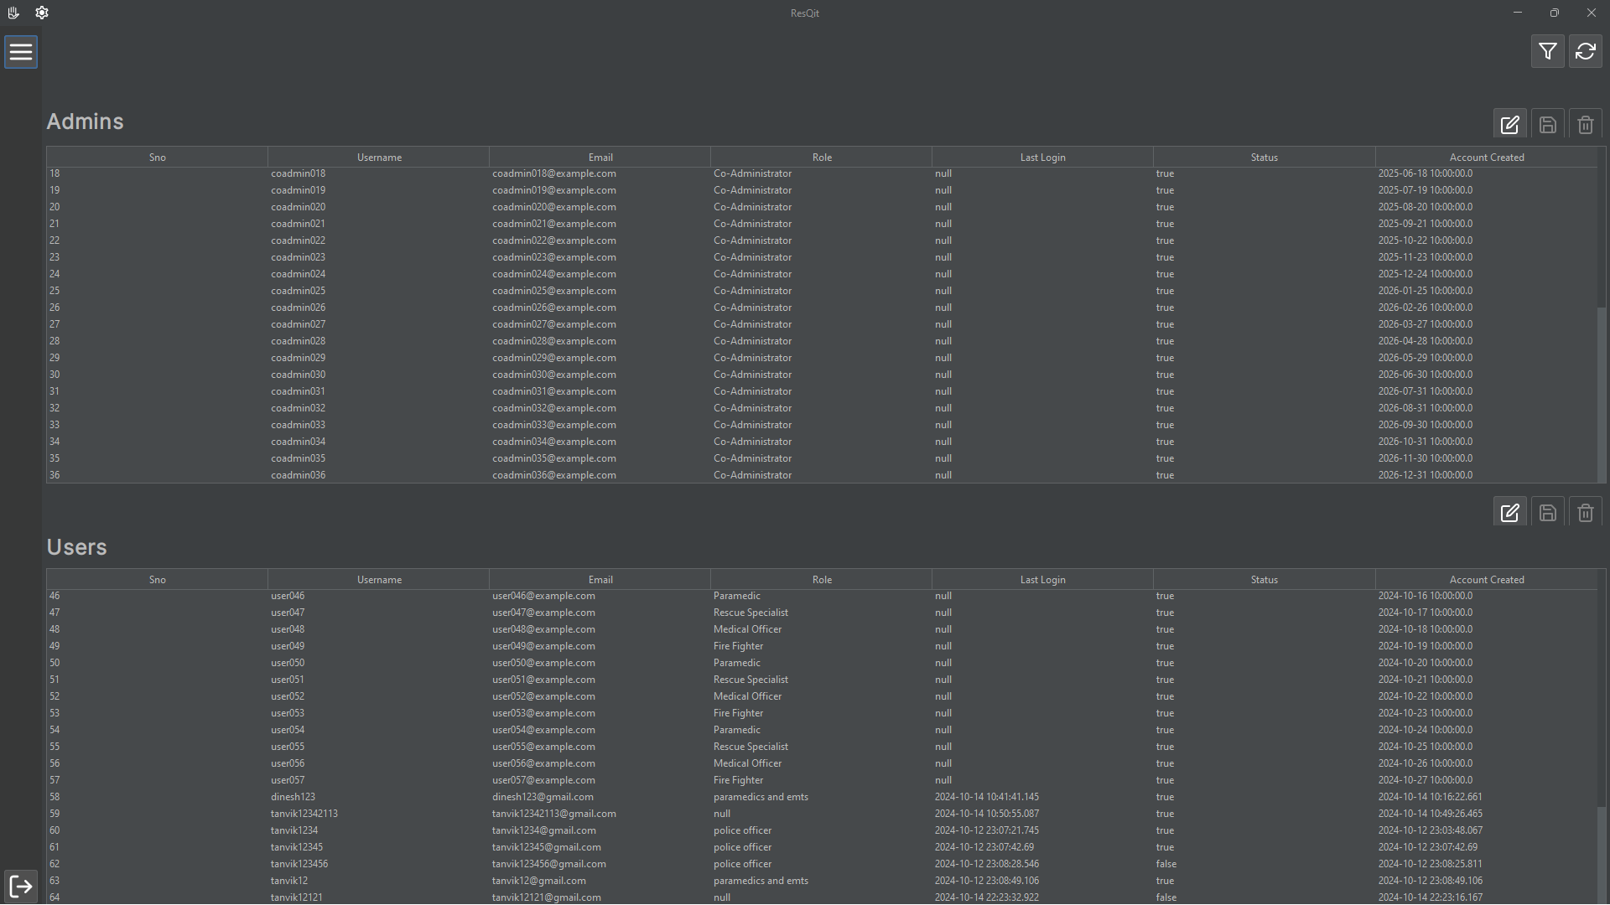
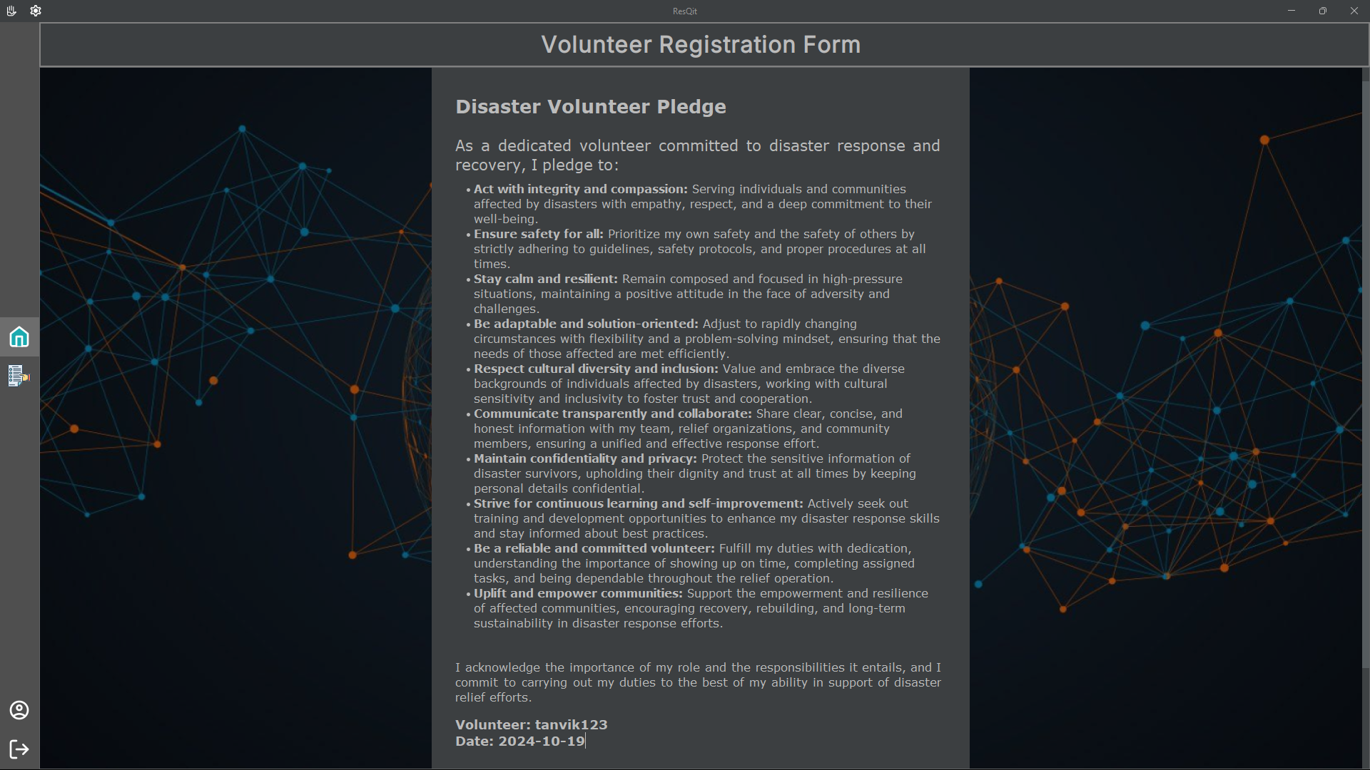
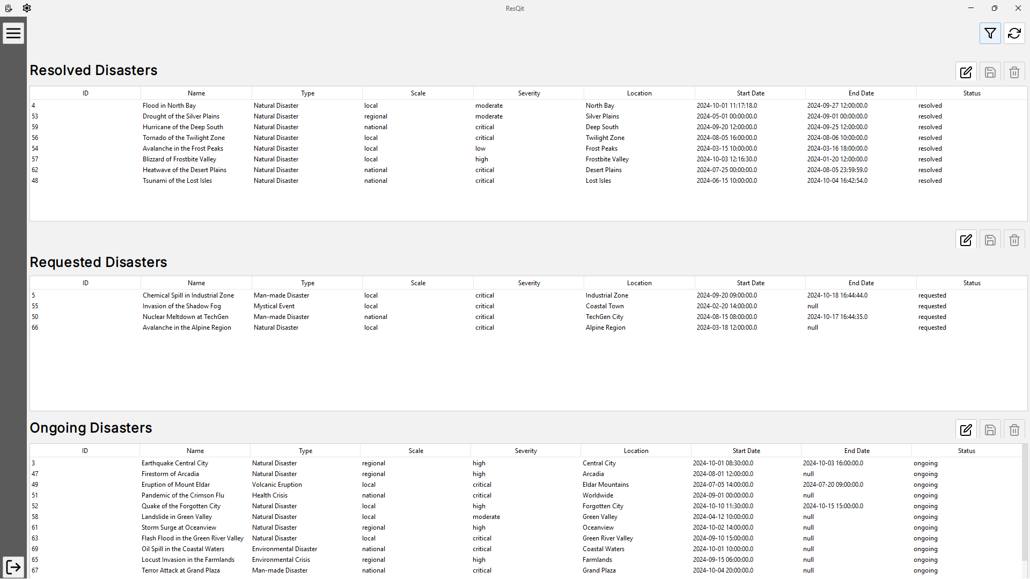
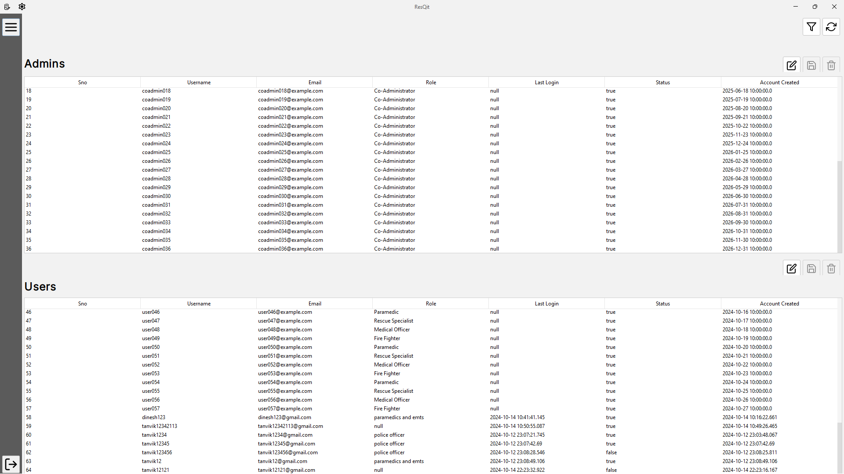
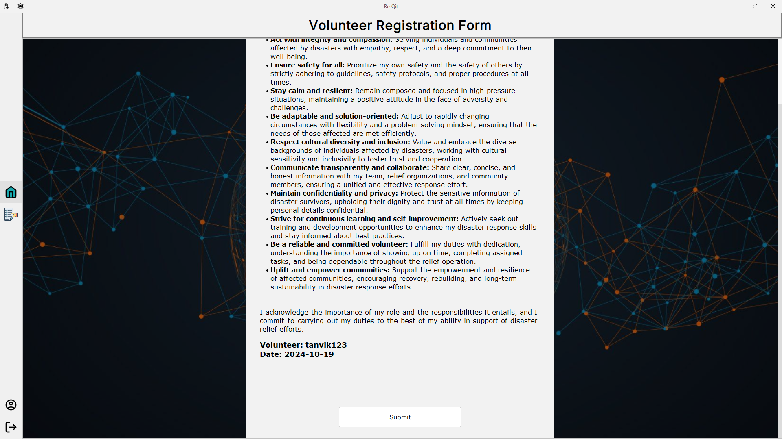
Disaster Admin Page
User Management Admin Page
Volunteer’s Page

Slide 15
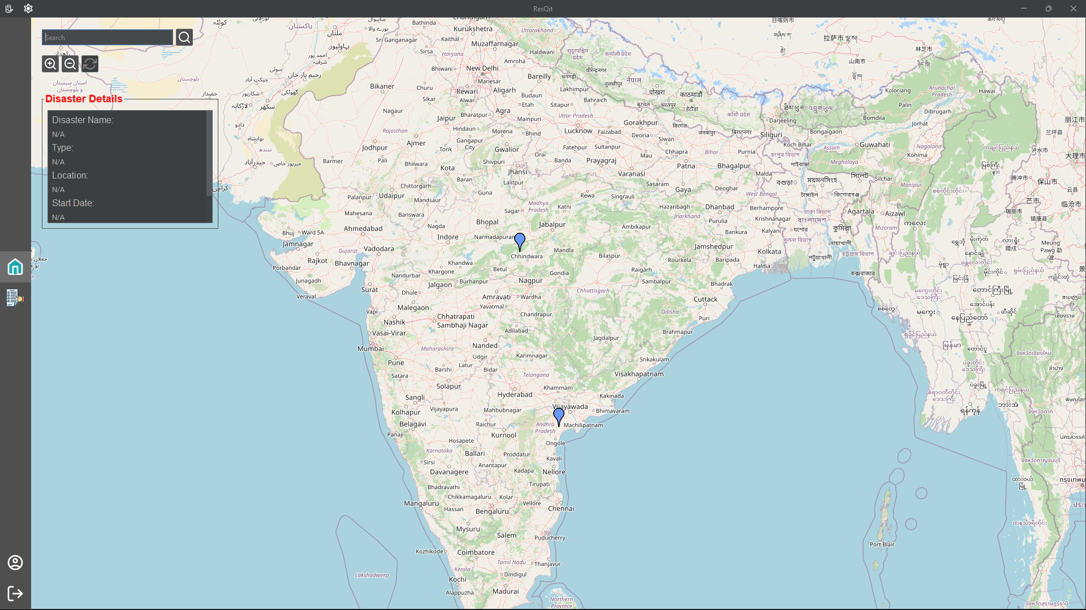
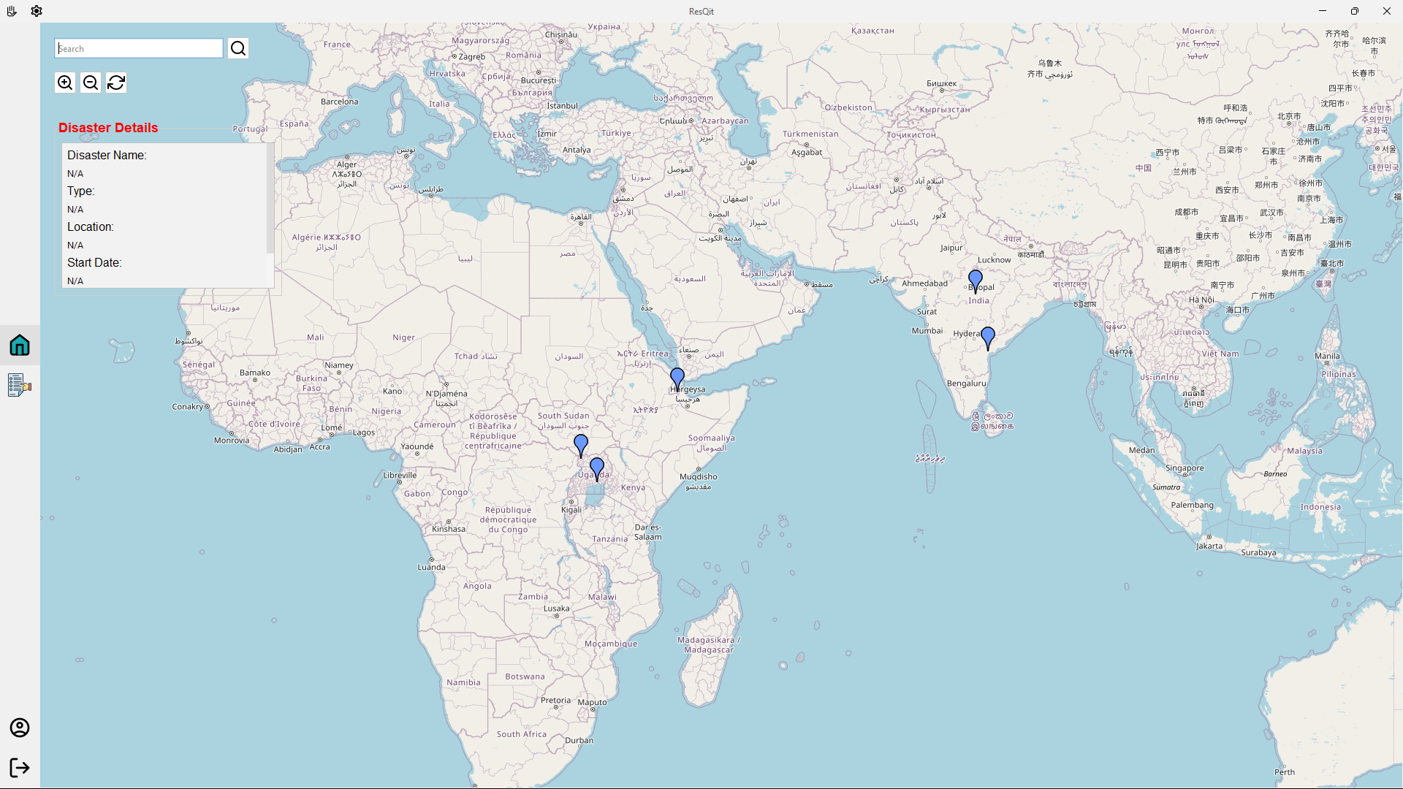
User’s Home Page

Slide 16

Thank you

